Slide 1
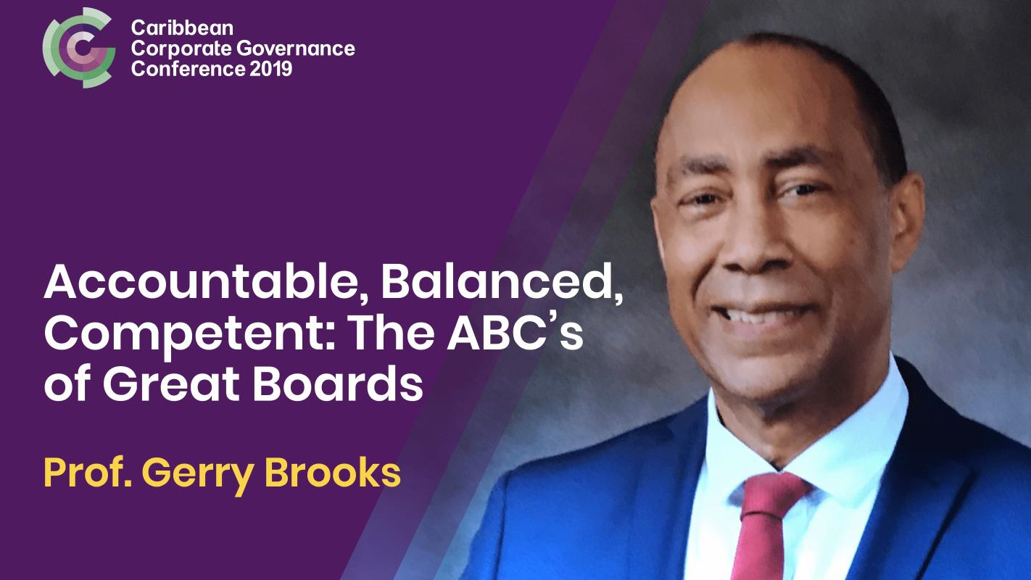

Slide 2




ABC’s of GREAT BOARDS
Accountable / Balanced / Competent
Prof. Gerry C. Brooks
Professor in Practice, UWI
October 30 , 2019

Slide 3
ABC’S OF GREAT BOARDS
Presentation Outline
“In the wake of meltdowns at Tyco, Enron, sexual harassment claims at Fox ...business disasters and scandals of such magnitude could [not] happen without gross or even criminal negligence on the part of the Board.” [1]
How do Boards prevent recurrence?
What makes Good Boards GREAT?
[1] Harvard Business Review, Sovenfeld, JA

Slide 4
Presentation outline
Presentation Outline
Glocal Context for High Performance Boards (HPB’s).
A
Accountability
B
Balance
C’s
Competence & Conflict
D
Disruptive Competitiveness
Concluding Thoughts.

Slide 5
GLOCAL context
Economic Growth located in a challenging GLOCAL environment with potential downside surprises.
Fourth Generation Technological Revolution is disruptive but exponentially opportunistic.
Hyper Competitive, Glocally Competitive Environment with new modalities of corporate behaviour testing traditional ethics and values.
Unprecedented Stakeholder Demands for consistent earnings growth and performance.
Blackberry
US Shale Gas
“Fortune 1000”
Petrotrin/Guacarra
Financial Services

Slide 6
… ‘The new Normal’
Disintermediate
Dislocate
Disrupt
E N E R G Y
G O V E R N M E N T
Disrupt & Dislocate
US & Shale
Guyana
Renewables
Arbitrage
Convergence
Disintermediation
e-Government
e-Services
Consumerism Competitiveness
Opportunities
e-Procurement
Business Reengineering
Fiscal Conditions
Divestments
Regional (Guyana)
Technological
Strategic M&A
State , Public & Private sector Boards must be Architects of the Future!

Slide 7

GREAT BOARDS are:
Architects
Enablers
Futurists
QUESTION:
Is Our Current Approach Enough to Deliver Transformative Results to Change Corporate & National Trajectory?
1. Does your Board enable Transformative Results?
2. Does the Business Model create a Platform for Success beyond 3-5 Years?
3. How can my Board and I become more Effective & Transformative?

Slide 8
Board effectiveness DIAGNOSTIC Shaped By Life Cycle & Circumstances
4-Phase Diagnostic
Characteristics | PHASE 1: Foundational | 2.Developed 3. Advanced | PHASE 4 Strategic
Lack of Clarity Poor Process Management Lack of Alignment Poor Team Dynamics Consistent Poor Results Board Composition | Survival Mode. Frequently change CEO’s. Crisis to Crisis. Dysfunctional. | Stability/ Penetrate new Markets Secure existing Markets/Tech as enabler Cost Focus/Being Bold | High Performance Co. Strong Visionary Leadership. Proactive. Redefine Industry.
Assess & Evaluate where Board & Company are Frankly!

Slide 9
Foundational Boards at Crisis or Developing Stage May Also Face…
Significant Governance Issues (Fraud & Financial Haemorrhage)
Cashflow Challenges & Financial Risk (Accountability)
Leadership Vacuum & Crisis
Reputational Risk, Statutory Penalties & Other Going Concern Issues
Resolve First! Create a Robust Foundation for Future!
Board may have to actively lead!

Slide 10
Raise Game to Create a
HIGH PERFORMANCE BOARD (HPB)
Research shows HPB’s focus on [2]:
Forward looking & proactive.
Value drivers.
Best Allocation of Resources.
1 – 5 1 - 5 1 - 5 1 - 5 1 - 5 1 - 5 1 - 5 | Strategy & Innovation Compliance. Performance and Execution Risk Management. Talent Management. Inorganic & Organic Growth. Governance & Accountability.
Analyse performance metrics.
Industry, global benchmarking.
Non-financial lead and lag metrics.
Aligned to corporate targets, KPIs & compensation.
[2] Mc Kinsey Bhagat & Kehoe

Slide 11

Enabling boards
Invest time!
Provide External, Innovative perspectives.
Insist on Accountability & Good Governance.
Manage Risk & Compliance.
Provide true Strategic Counsel.
Create valued new networks and connectivity.

Slide 12

Accountability

Slide 13
Accountability
“Headlines are filled with the latest corporate scandals… Uber’s defective culture, CEO misconduct… reprehensible comments by Board members at USC…Wells Fargo … another scandal….just when it was dealing with the sales scandal (Nissan, Facebook, UnitedHealthcare).” [3]
Corporate Boards should be subjected to
GREATER SCRUTINY & ACCOUNTABILITY
[3] Michael Volkov -2017

Slide 14

Accountability – LAW & ETHICS
LEGAL DUTY TO COMPANY TO:
  1. Follow applicable Laws, Regulations & Standards.
    Hold Management accountable for results.
    Provide Relief in event of Directors’ duties.
  2. Owe Ethical Duty & Responsibilities.
  3. JV Boards & Minority Boards.
    Requires more savvy & experience.

Slide 15
ACCOUNTABILITY- TRAPS & PITFALLS
TRAPS & PITFALLS
DIRECTORS MUST:
Unwitting collusion with management to circumvent controls.
Blurred lines between shareholder and Board.
State sector political interference.
Ignorance of legal requirements.
Prepare and Educate Self.
Work closely with Risk & Compliance.
Avoid CEO/Chairperson being same
Not be glorified rubber stamp!.
Get D&O Insurance

Slide 16
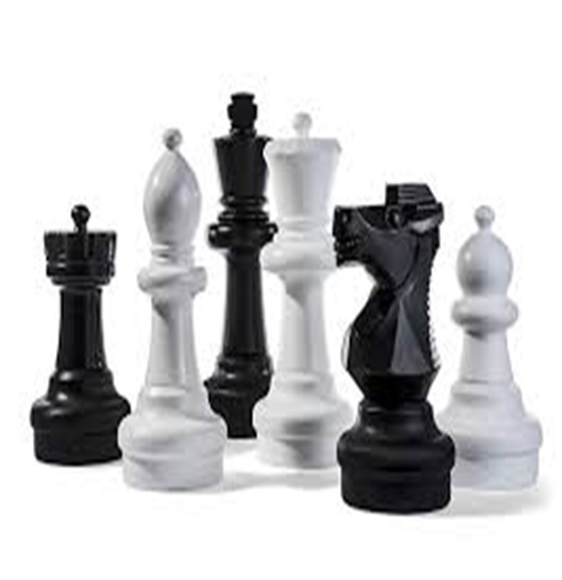
Balance

Slide 17
Balance
“Balanced Boards function as a High Performance Team that is Competent, Coordinated, Collegial and Focussed on Strategic, Consistent Creation of Stakeholder Value.”
“Such entities don’t just evolve. They must be created to an Exacting Blue Print.” [4]
[4] Nadler HBR.

Slide 18
Balanced Board
Fundamental To Success
Conduct periodic Self-Assessments and address results.
Inventory Director strengths & weakness to ensure “Board Muscle”.
Board balance and diversification are enablers of confidence, innovation, and transformation. (“Size matters but is not only factor.”)
Balanced Boards foster engaged culture and trust characterized by candor, vigorous discussion and confidentiality.
The Role and Direction of Chairman is Crucial to Balance.

Slide 19

COMPETENCE

Slide 20
Competence
A Vital Ingredient!
  Ask the probing questions!
  Challenge/question management.
  Drive competitiveness!
Broad Competence must be reinforced by Industry Knowledge.
Be prepared to deal with conflict of interests!
Build Board Competencies to address gaps identified in Board Evaluation.
Elevate Competence to Obsessive Commitment!
Avoid Partisanship and Political Patronage!
Deliberately build Diversity and Contrarian perspectives.

Slide 21
CONFLICTS & CONFLICTS OF INTEREST
“Conflicts of Interest abound. They affect ethics, distort decision making and create reputational risks and law suits. Conflicts undermine credibility of Boards, the organisation and entire economic systems.”[5]
How to address and resolve in an efficient, effective manner?
[5] IMD Global Board Centre, Professor Cossin

Slide 22
ELEMENTS of DISRUPTIVE COMPETITIVENESS
Consumerism Customer Independence
Hyper Competition
Glocality
3 D’s
Digitization & Technology
Boards must embrace and drive Disruptive Competitiveness.

Slide 23
PHILOSOPHY of DISRUPTIVE COMPETITIVENESS!
Setting the benchmark
Shape the playing field
Be guided by purpose
Re-invent the value proposition [6]
Industry Consolidation
[6] Manlight & Dhanraj
Notes:
Disruption cannot occur by doing the same thing for decades. Understanding the customer and knowing when the value proposition changes is important. Difference between baby boomers and millennials.
I spend a lot of time with various company boards …..
Industry consolidation is taking place as companies grow by M&A to secure and control greater share of the value chain. Disney acquired Lucas Arts (Star Wars), Marvel Studios, Pixar. Integrate with its theme parks etc. Now its fastest growing segment.

Slide 24



Thank You.
B&B
ADR
Professor Gerry C. Brooks
1 868 775 8000 or 610-9DRF
gerrybrooks13@gmail.com

