Slide 1


Slide 2

MILLENNIALS...
WHO ARE THEY?
Up to a few years ago Millennials were defined as anyone born between 1977 to 1997.
In 2018/2019, researchers and institutes, such as PEW Research redefined Millennials as anyone born between 1981 and 1996 (ages 23 to 38 in 2019).

Slide 3
MILLENNIALS...
WHY ARE THEY IMPORTANT?
One of the largest generations in history are either already in, or about to move into the prime of adulthood.
Millennials are poised to reshape the economy; their unique experiences will change the ways we do business, buy and sell, forcing companies to examine how they operate for decades to come.

Slide 4
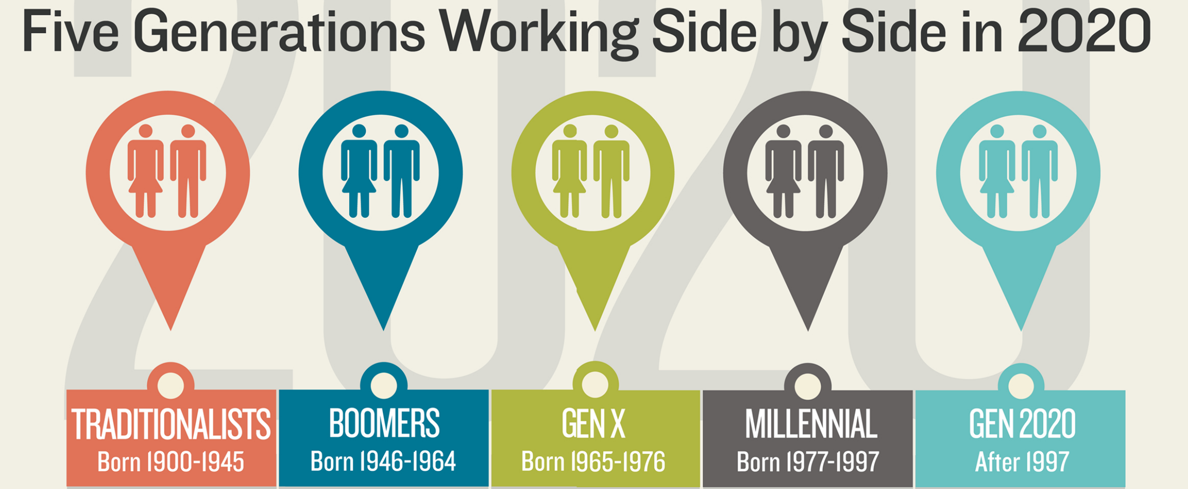
GENERATIONAL DIFFERENCE
Disciplined
Workplace Loyalty
Experiential
Innovators
Hard Working
Independent
Free Agents
Mobile Phones
Immediacy
Confidence
Diversity
Social Media
Optimistic
High Expectations
Apps | AI| Big Data

Slide 6
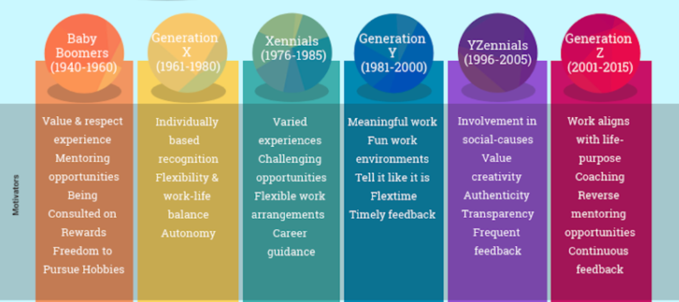
GENERATIONAL DIFFERENCE
Credit: Dr. Poornima Luthra

Slide 7
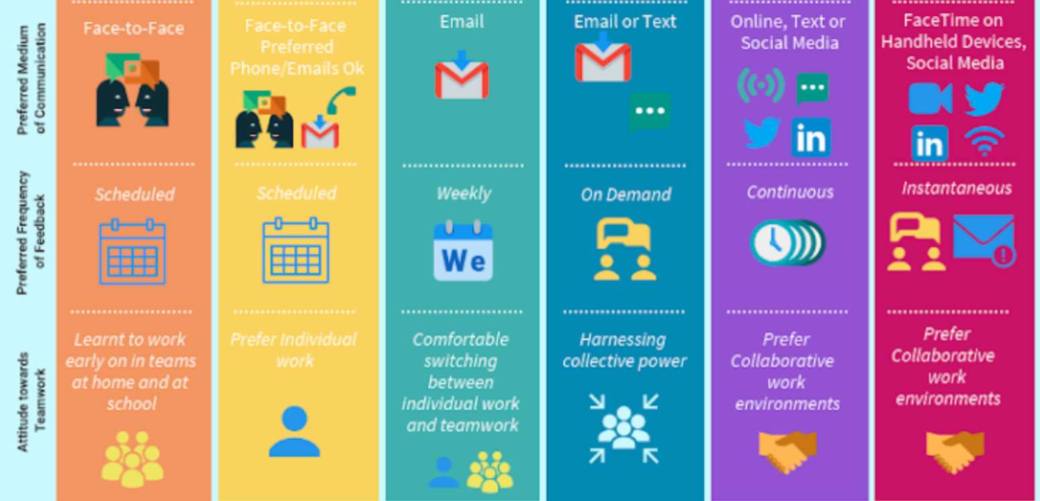
GENERATIONAL DIFFERENCE
Credit: Dr. Poornima Luthra

Slide 8
IQ…EQ…CQ…GQ!
Generational Intelligence, in the age of the most age – diverse workforce……
Understand your G’s
Recognise Generational Conflict
Empathise and Rationalise
Mindfulness and Strategic Motivation

Slide 9
MILLENNIALS...
WHY ARE THEY IMPORTANT?
A different world, a different worldview. Millennials have grown up in a time of rapid change, giving them a set of priorities and expectations sharply different from previous generations.
The largest generation to date, the first digital natives, more social and well connected, with less money to spend and beyond their professional careers, have no fixed timelines to settle down, start a family, or own a home.

Slide 10
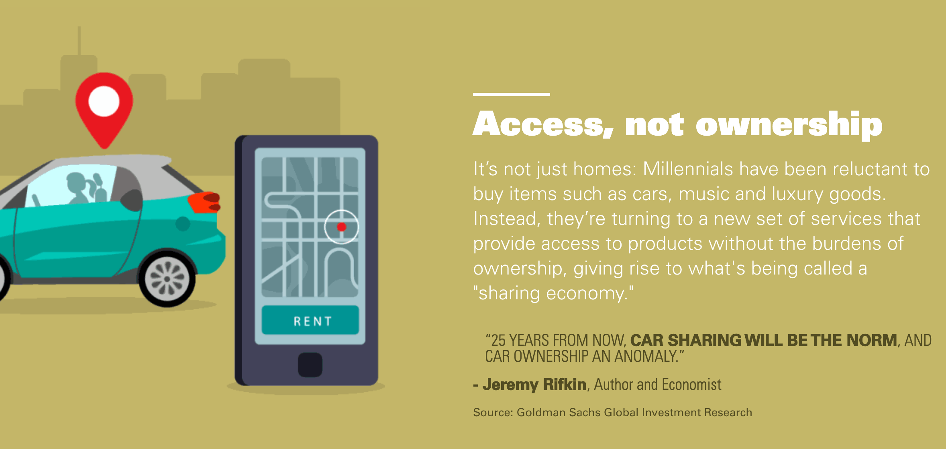
MILLENNIALS...
A preference of access over ownership…

Slide 11
Millennials at the forefront of the…
SHARING ECONOMY
The sharing economy is built on the idea of collaborative consumption. Collaborative consumption, is when only a few individuals own the goods, but other people can pay to use same. Basically, it's a monetized form of sharing.
The sharing economy increases the supply of goods and services, which in turn makes them more affordable.

Slide 12







Companies leading the…
SHARING ECONOMY
Airbnb is a prime example of a global company that makes the sharing economy possible. In case you've never used it, the platform allows for individuals to make money by renting out an unused room or property.
As at 2019, 76% of all Airbnb listings are outside traditional hotel sectors

Slide 14
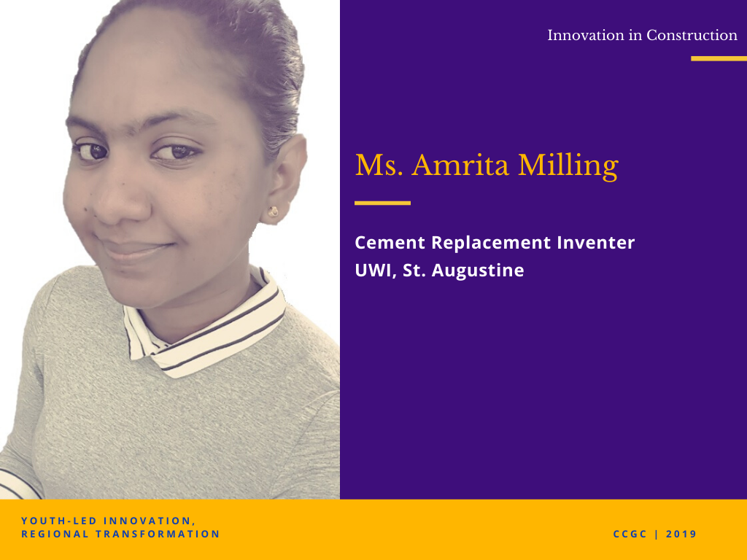
MAIN HEADING FONT 48 PT
SUB-HEADING FONT 30-36PT
BODY TEXT FONT 18 – 24 PT

Slide 15
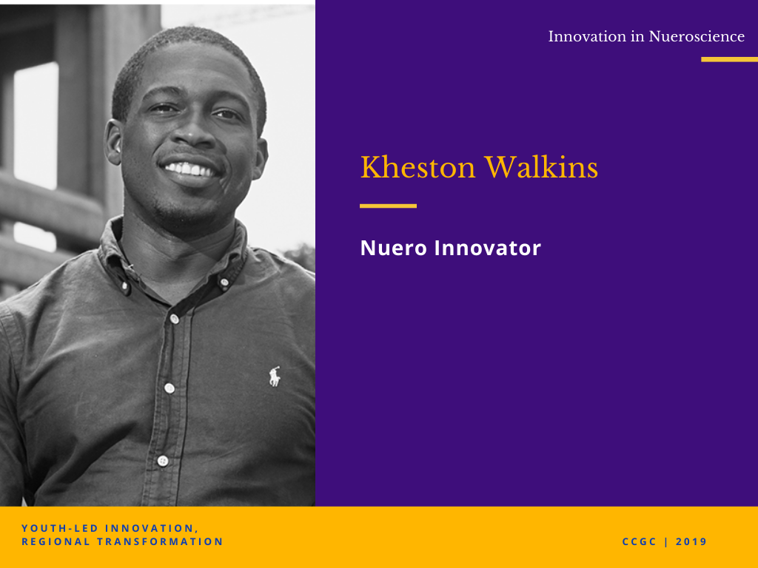
MAIN HEADING FONT 48 PT
SUB-HEADING FONT 30-36PT
BODY TEXT FONT 18 – 24 PT

Slide 16
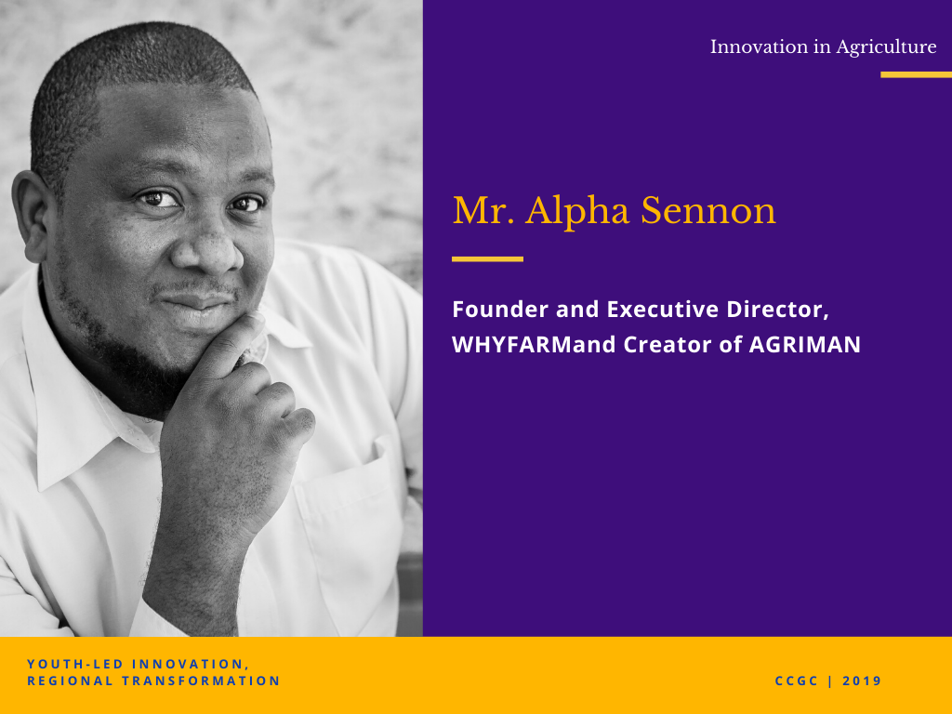
MAIN HEADING FONT 48 PT
SUB-HEADING FONT 30-36PT
BODY TEXT FONT 18 – 24 PT

Slide 17
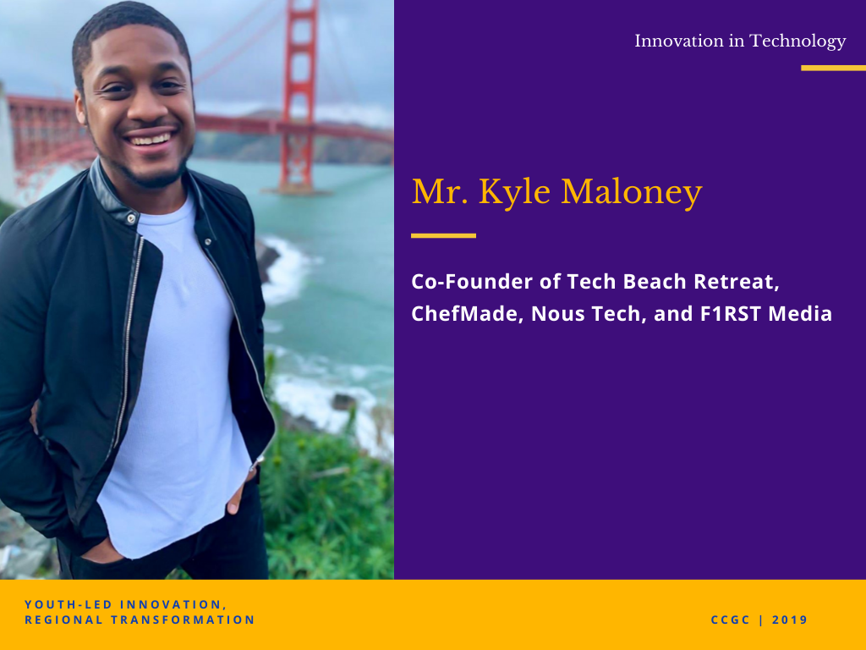
MAIN HEADING FONT 48 PT
SUB-HEADING FONT 30-36PT
BODY TEXT FONT 18 – 24 PT

Slide 19


